Slide 1

18CSE392T – Machine Learning I
Department of Data Science and Business Systems

Slide 2
Bias vs Variance trade off

Slide 3
Bias and Variance
The prediction errors in a model prediction includes
Bias
Variance
The understanding about these errors helps us to
Build an accurate model
And avoids overfitting and underfitting

Slide 4
Bias
Definition
Difference between predicted value and actual value
If the bias is too high , predicted value is faraway from the actual value

Slide 5
Variance
Definition
Variance is the change in prediction accuracy
When the test data is not performed well as the train data, the model will vary

Slide 6
Bias Variance – Trade off
If the model is too simple and has few parameters then it is having High Bias and Low Variance
If the model is having large number of parameters then it is having High Variance and Low Bias

Slide 7
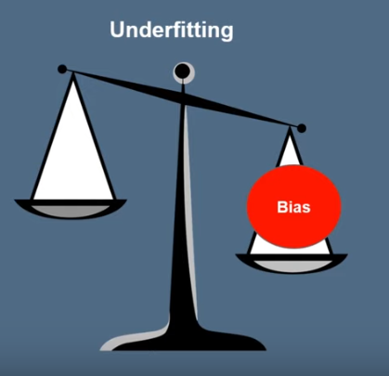
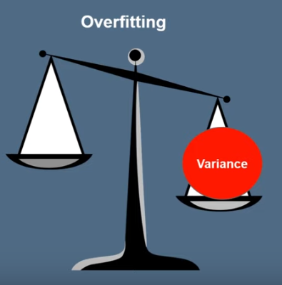
High Bias & High Variance

Slide 8
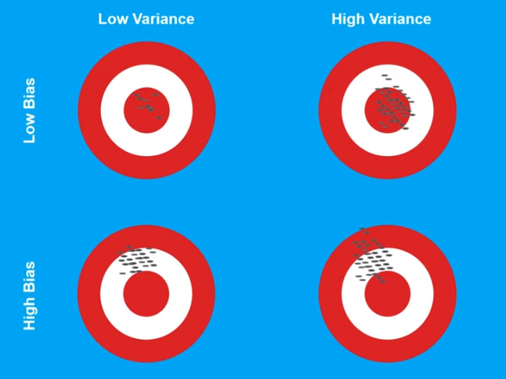
Scenarios

Slide 9
Summary
Difference between the predicted value and the actual value
Spread of data
High Variance - Occurs when a model trains the training data much which in turn has high errors on test data.
High Bias - Occurs when a model not properly trained for training data which in turn has high error on both training and test data.

Slide 10


